Slide 1
Selecting an optimal location for a new BBQ restaurant in Austin, TX
Coursera Data Science Capstone Project
4/22/2020

Slide 2
Introduction
Austin, TX is widely considered a hotspot for Barbeque in the United States
Foursquare shows nearly 100 restaurants catering to this specific type of food with a population of only 2 million
While there is lots of competition, there is likely plenty of “room” for someone to achieve their dream of opening up their own restaurant
…. But WHERE?

Slide 3
Data
Most data for this project will come from Foursquare, using their “venues” API
This data will be supplemented by socioeconomic data at the Zip Code level from ZipAtlas.com
Population
Population density per square mile
Average income per person

Slide 4
Methodology
Visual inspection of scatter plots of restaurant count within zip code versus each of:
Population
Population Density
Average income
Use DBSCAN (unsupervised machine learning algorithm) to cluster existing restaurants by location

Slide 5
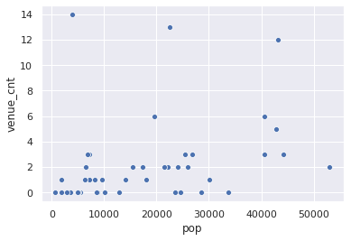
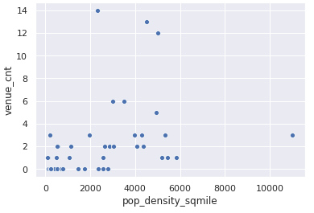
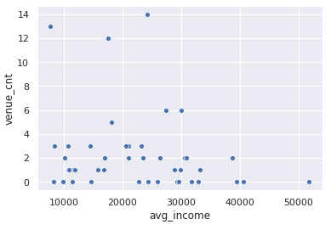
Results – Correlating restaurant count by zip code with population, population density, and average income
No clear relationships between sampled data
Population, population density, average income are not predictors of where restaurants should be

Slide 6
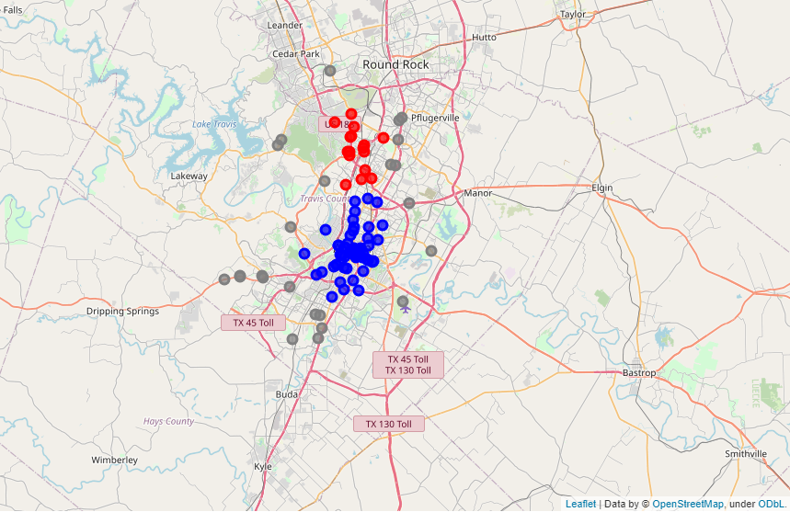
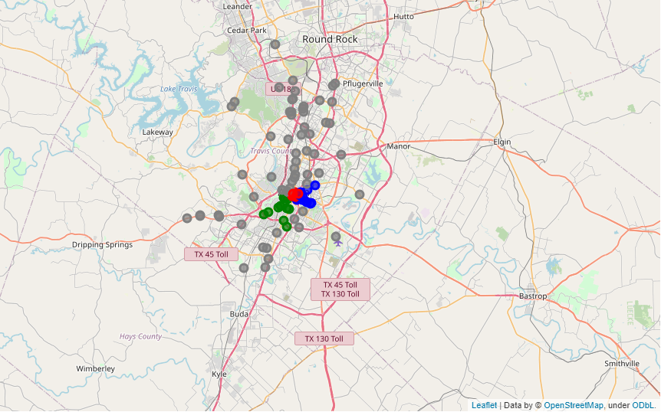
Results – DBSCAN Clustering
DBSCAN allows clustering that truly segments based on geographic similarity, completely ignoring outliers when determining “neighbors”
Clustering based solely on location is shown on the left
Location-based clustering on the right also incorporates population density, showing clusters only for the downtown area (as expected)

Slide 7
Conclusions
Despite the lack of clear insight from the compiled dataset, the process of gathering, cleaning, and exploring the dataset with still a fun and worthwhile experience.
The full experience provided great practice in the art of using python for data analytics and data science.
Solving a problem without a known end goal provides a unique experience from structured labs because it forces the learner to overcome challenges throughout the course of the project.
Gathering data from multiple sources via web APIs and web scraping, combining those sources together, and cleaning the data can have a daunting array of challenges come up, and solving those provides a wealth of applicable experience.

